Slide 1
Video Gallery Extension

Slide 2
ABOUT THIS MANUAL
By Tutorial User Guide User Will be able to learn the basic Features of By Tutorial Module. At the End of this Tutorial the User Will be able to learn the Following Activities.
Create Classification Groups.
Add YouTube/Vimeo Links to the Created Groups.
Enable/Disable a Videos.
Display the Videos in The Home Page in Features Videos Column

Slide 3
Classification Module

Slide 4
Chapter 1 : Classification Group
This Module is basically an Interface which will be used for Adding the Classification Groups.
Following Screenshots provide the Detailed Flow of how to add/edit and view the Classifications from Admin Module.

Slide 5
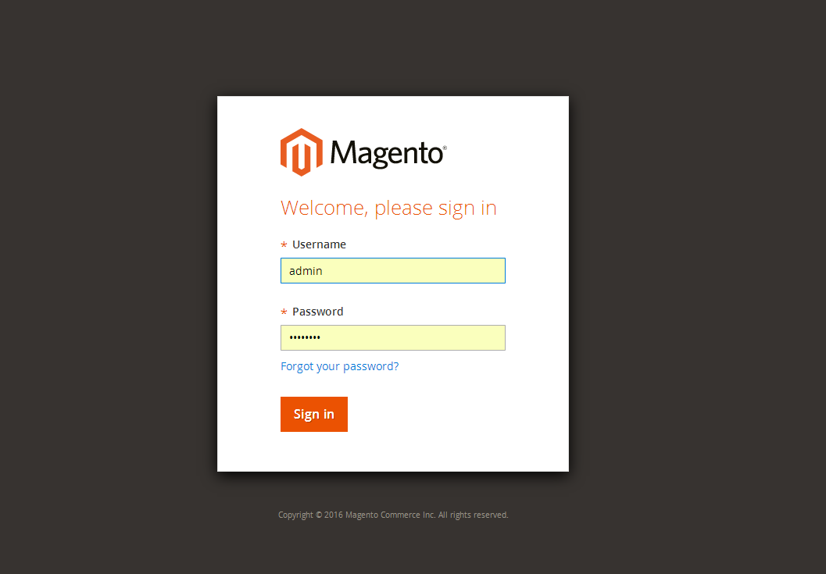
Login as Admin using admin credentials.

Slide 6
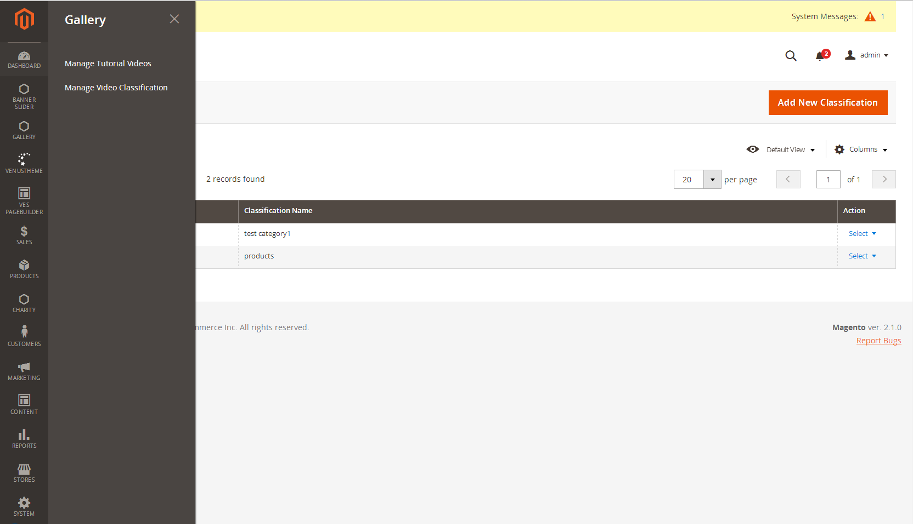
Navigating to Video Classification Link
Gallery Manage Video Classification

Slide 7
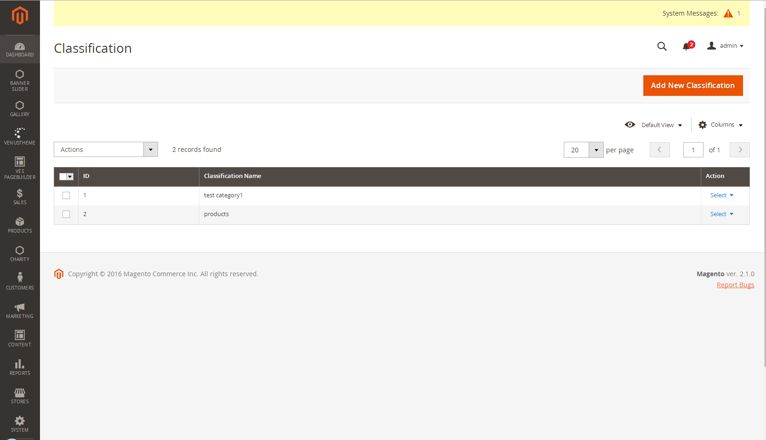
Grid View Of Classification Groups

Slide 8
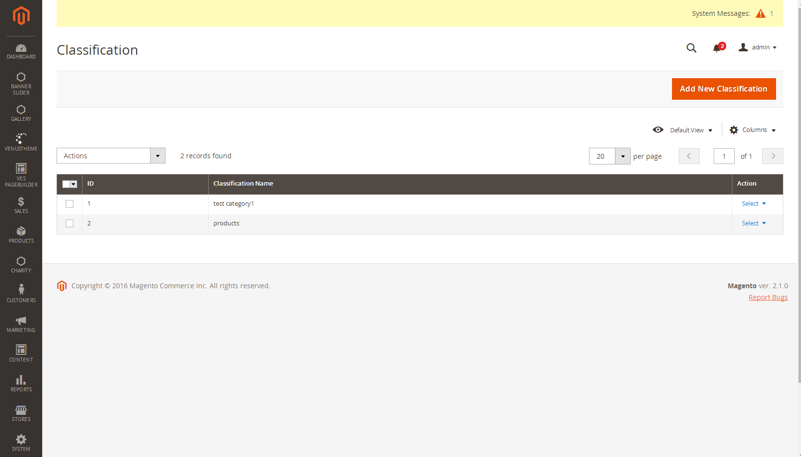
Navigating to Add Classification Group

Slide 9
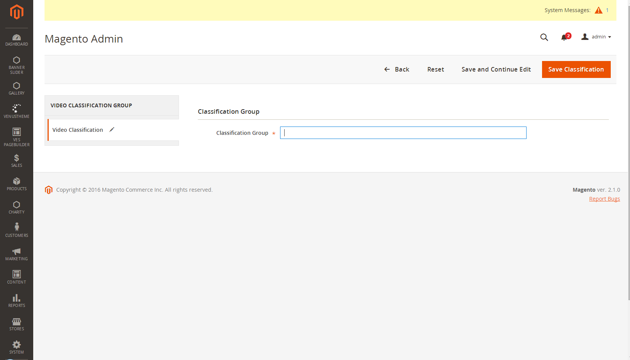
Add Classification Screen

Slide 10
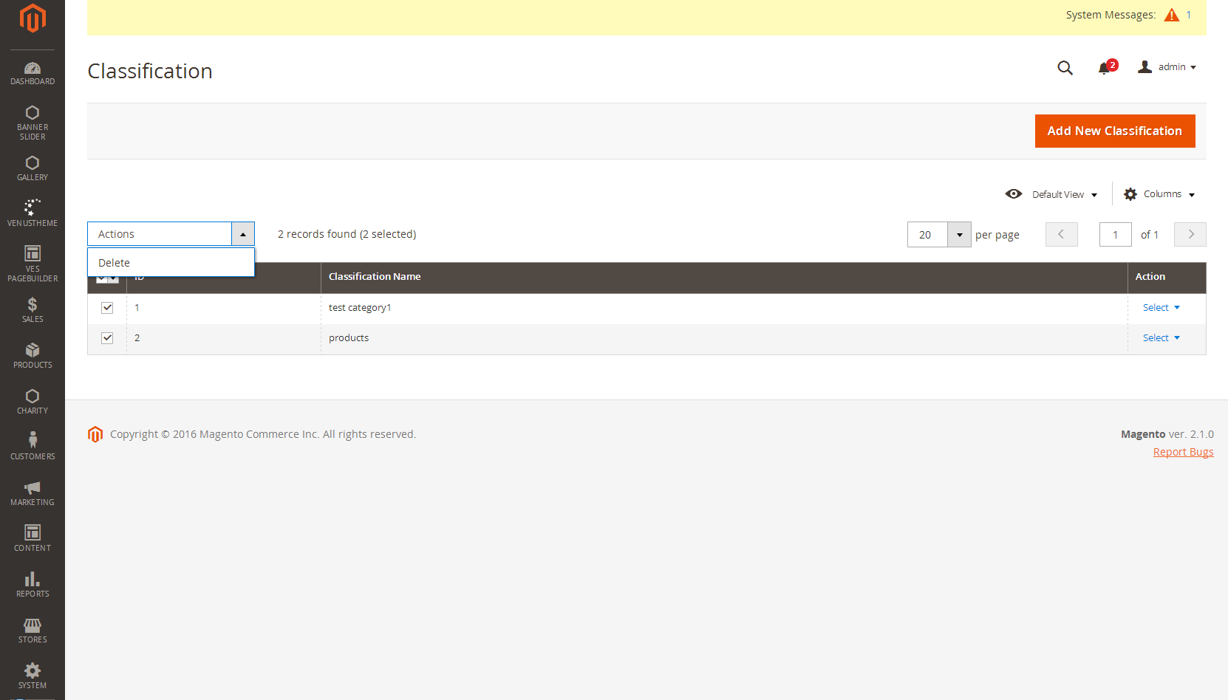
Mass Deletion Of Classification Groups

Slide 11
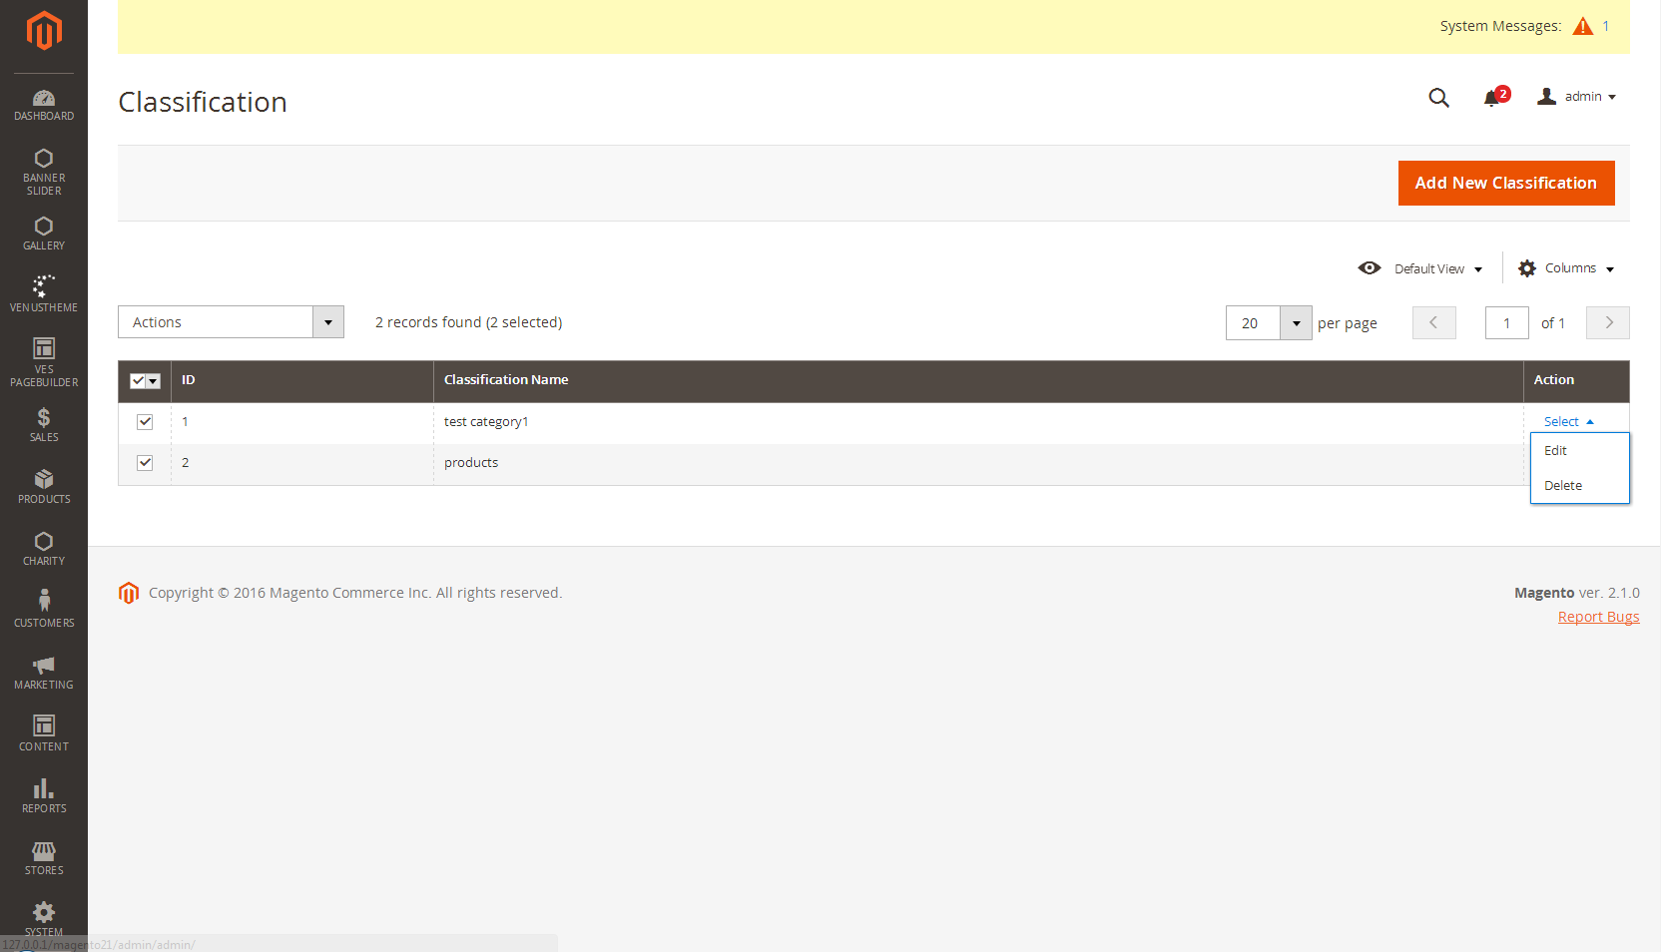
Single Classification Delete

Slide 12
Single Classification Edit

Slide 13
Gallery Module

Slide 14
Chapter 2 : Video Gallery
This Module is basically an Interface to add Video Links and map them to the Classification Groups Which are created in the Previous Module.
Following Screenshots will provide the Detailed Flow of
How to add/edit and delete Videos.
Enabling and disabling a video to be shown in tutorial Page.
Display the videos in Featured Video Section.

Slide 15
Login as Admin using admin credentials.

Slide 16
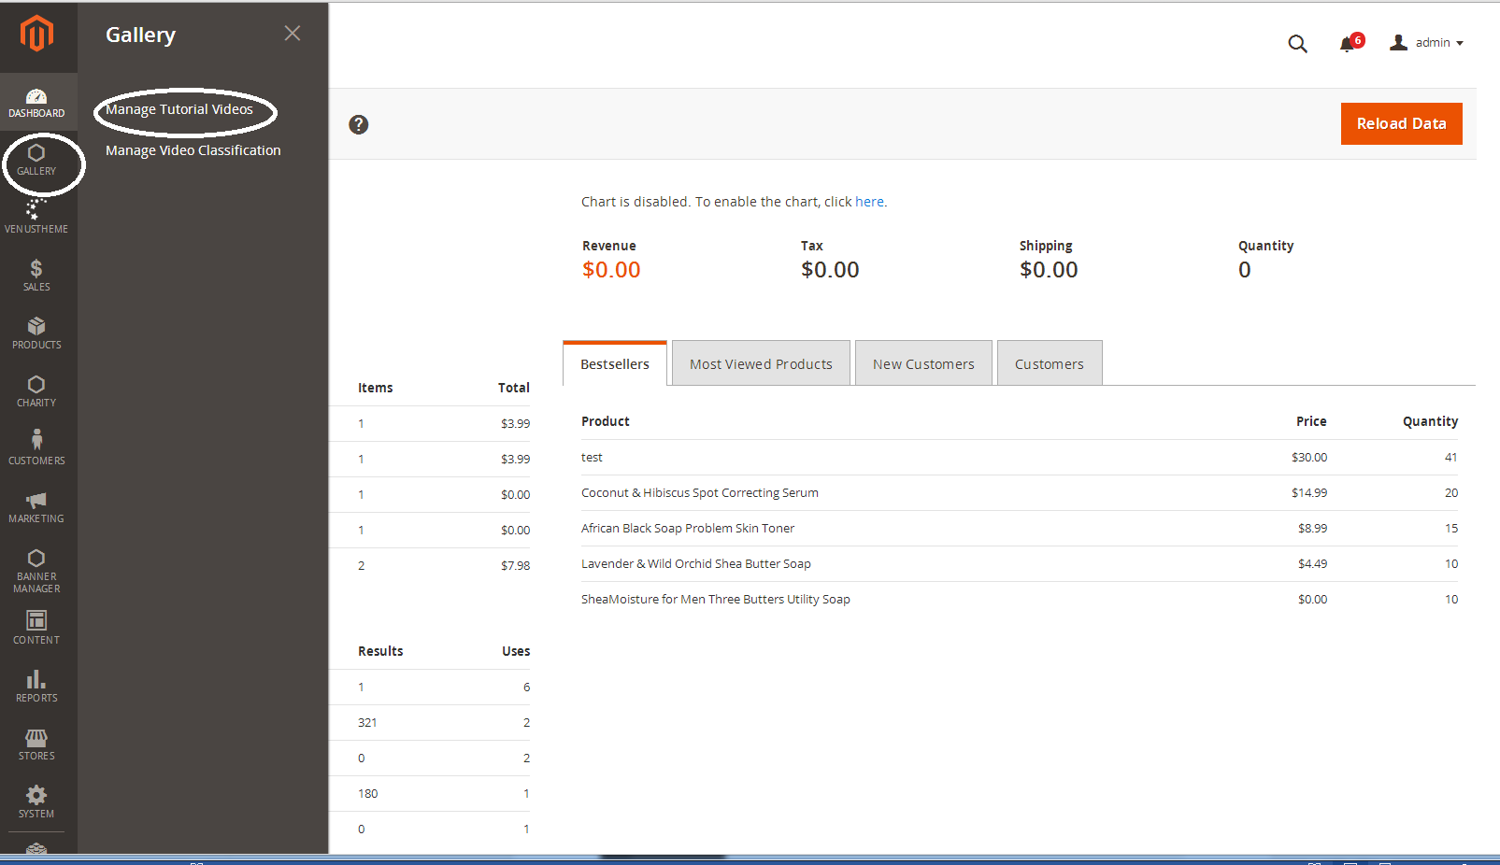
Navigating to Video Gallery Module
Gallery Manage Tutorial Videos

Slide 17
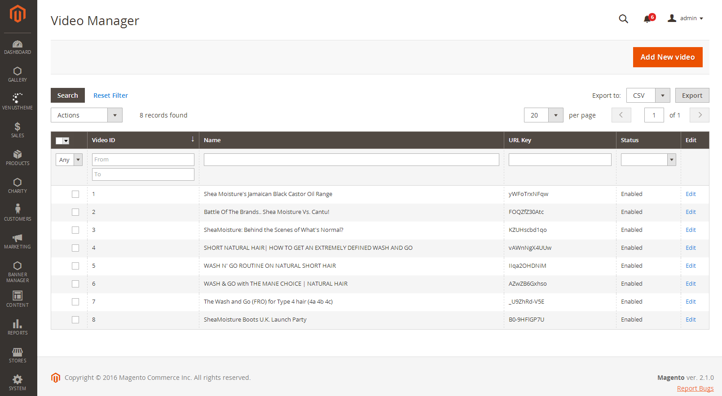
Grid View Of Video Manager Page

Slide 18
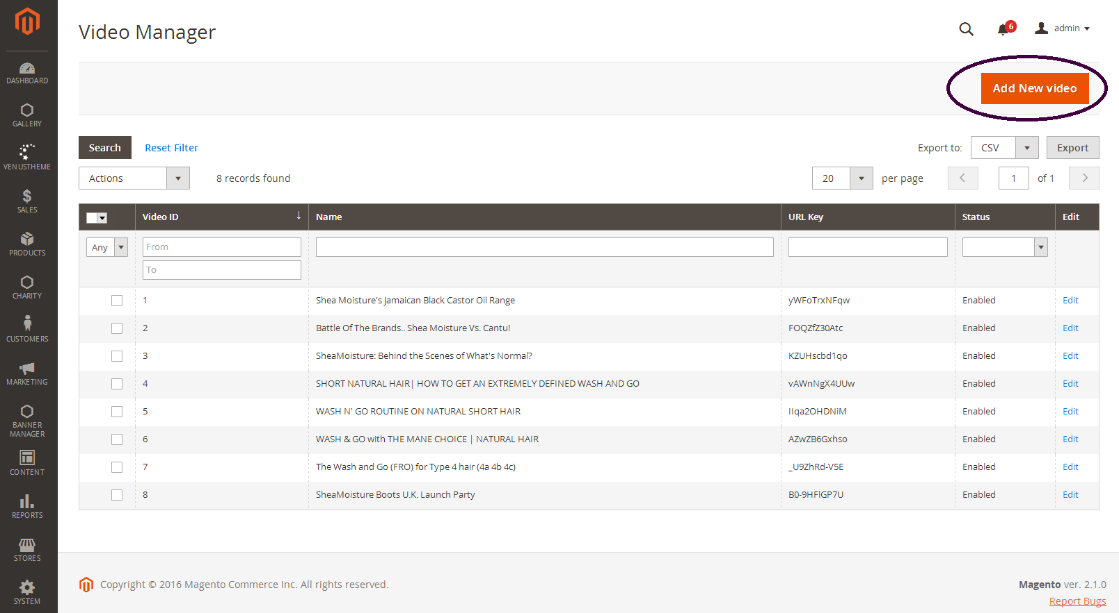
Navigating to Add Video Page

Slide 19
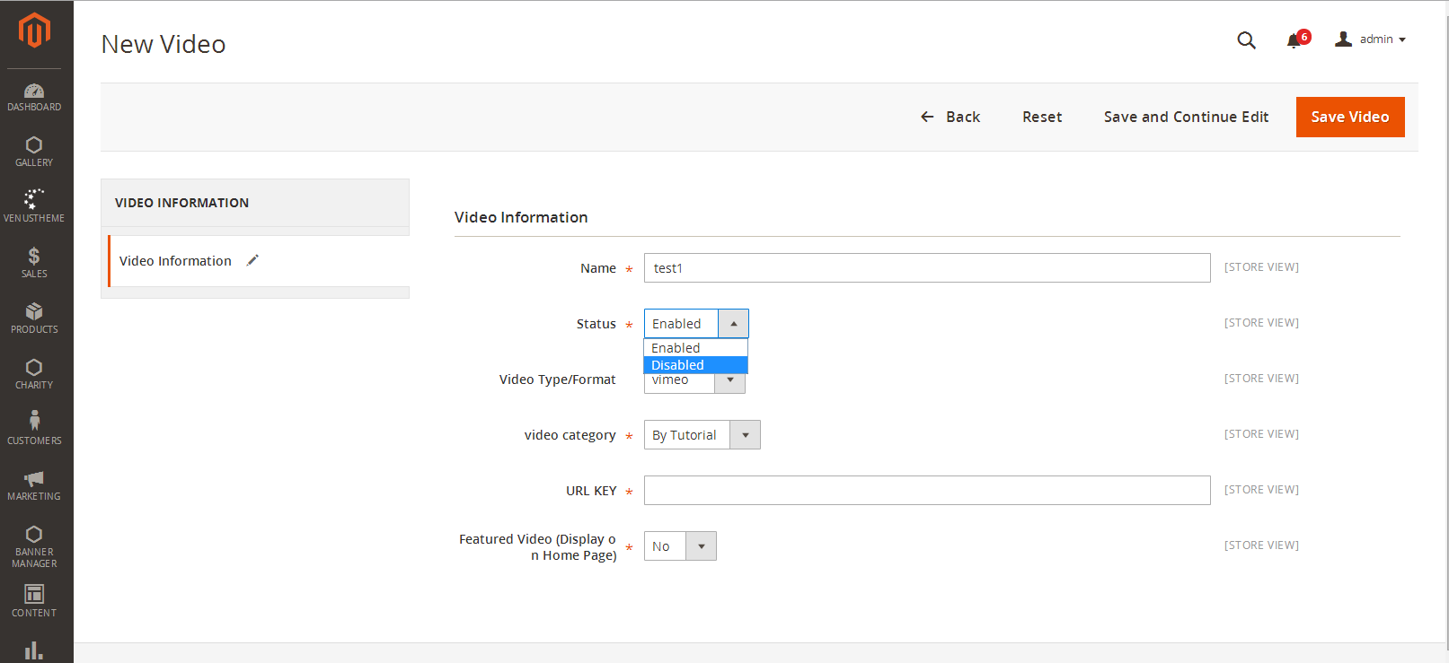
Screen 1

Slide 20
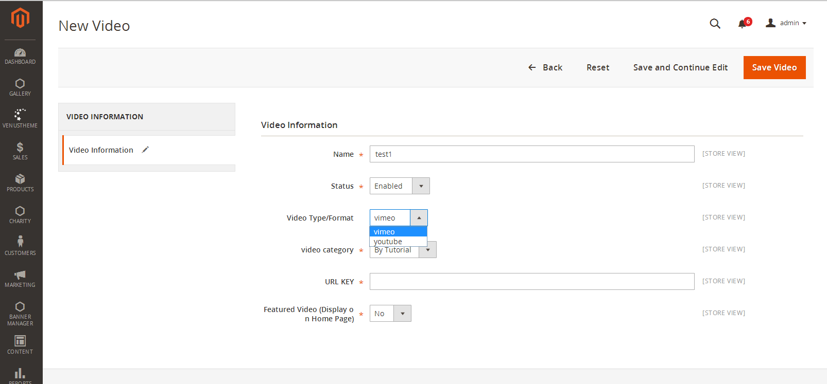
Select the Format of the Video.
Two Type of Video Formats are allowed.

Slide 21
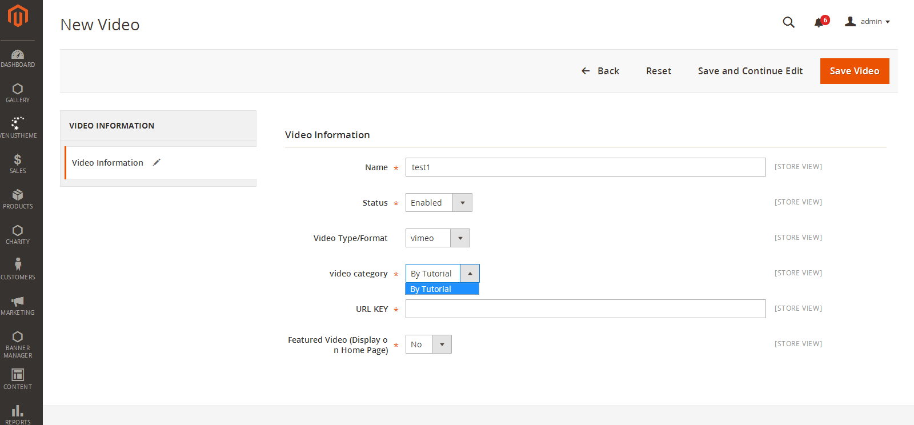
List of the classification groups created in classification Module

Slide 22
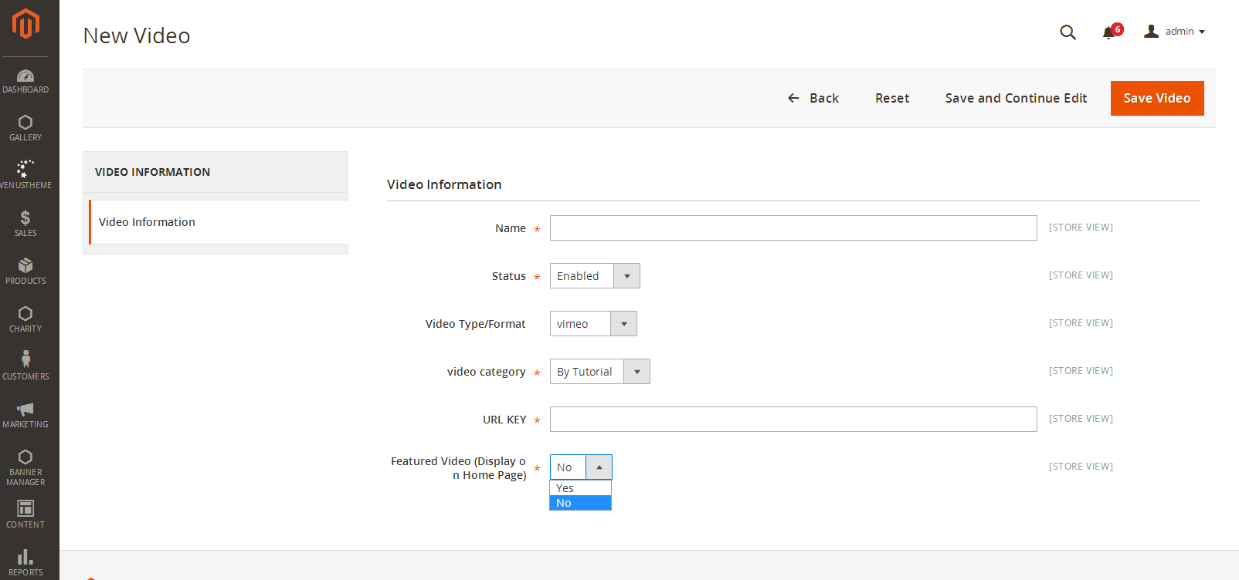
For each video of youtube/vimeo there would be a unique URL defined.This Url need to entered into the textbox.
For Example :
Youtube URL :- https://www.youtube.com/watch?v=5AvVsWT7ONE
URL Key :- 5AvVsWT7ONE
Vimeo URL :- https://vimeo.com/187593782
URL Key :- 187593782
Yes – Displays the Video as Featured Video
No – Displays in the Tutorial Page.

Slide 23
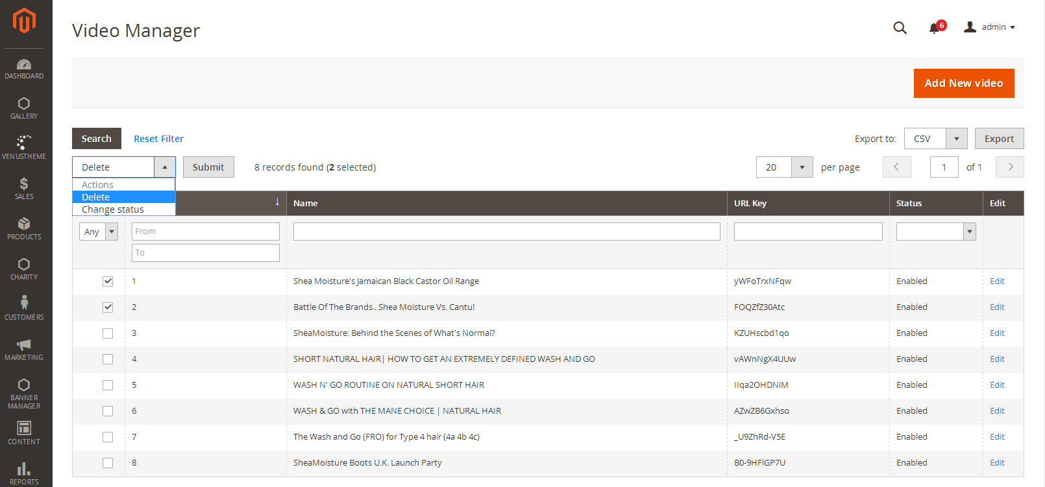
Mass Delete Videos
Screen 1

Slide 24
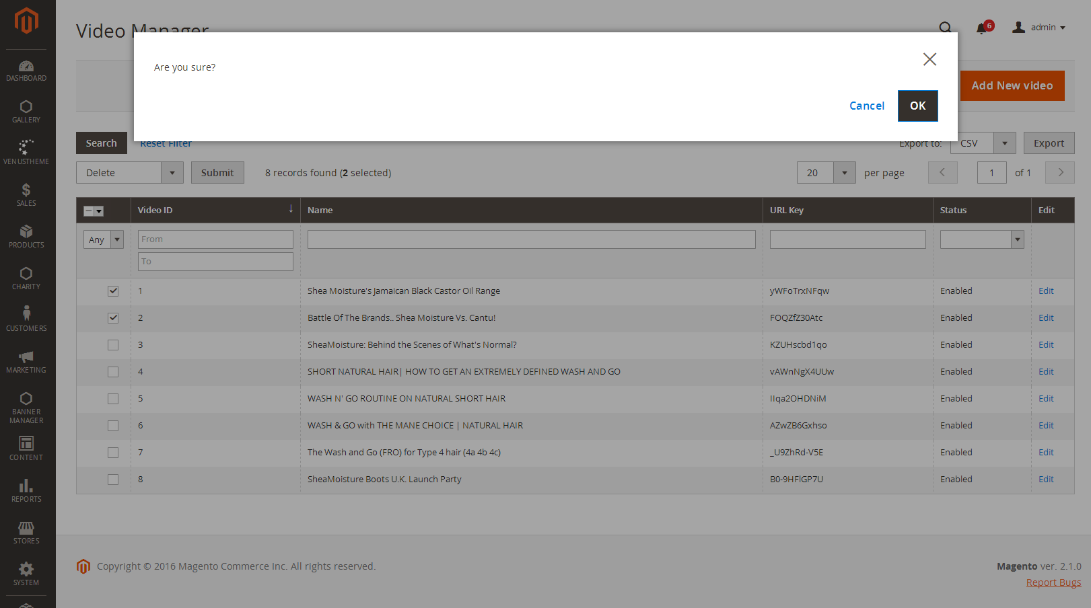
Screen 2

Slide 25

Featured Videos

Slide 26
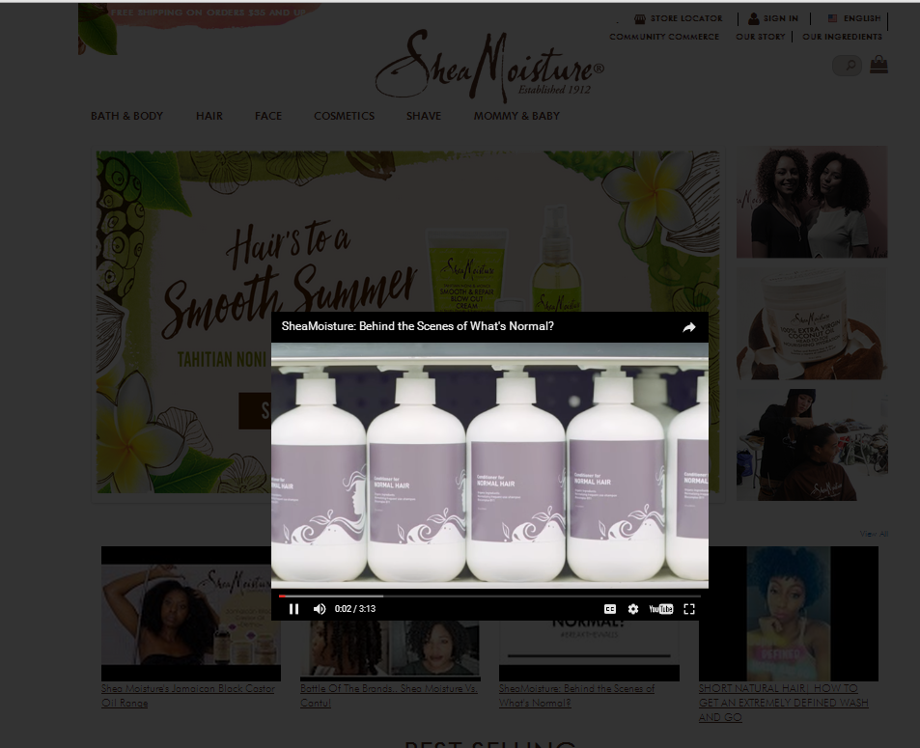
On Click of the Featured Video,It Opens in a lightbox.

